Slide 1
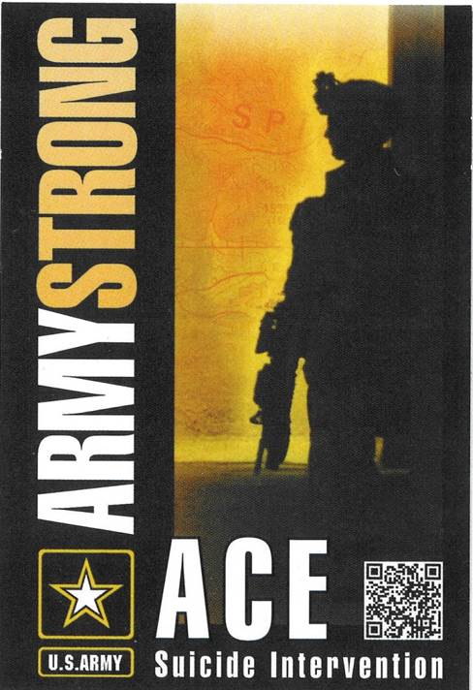
ACE-SI Ask, Care, Escort- Suicide Intervention Course (Army First Line Leaders, Army Civilian Supervisors, and Family Readiness Group Leaders) U. S. Army Suicide Prevention Website: www.preventsuicide.army.mil Military Crisis Line (National Suicide Prevention Lifeline) 800-273-TALK (8255) press 1 (text 838255) www.veteranscrisisline.net (online chat)
1
Notes:
Directions: Display slide as you discuss the following talking points. Look at the Example Speaker’s Notes to see a suggestion of how to talk about this section. Make sure everyone signs in on the sign in sheet.
Talking Points:
Introduce yourself and co-facilitator.
Welcome participants, give name of training, housekeeping details.
Ground Rules:
No one leaves without speaking to one of the facilitators first (You may need to make a call, take a bathroom break, or you may have a response to the training and need some time to collect your thoughts.)
Everyone is expected to participate.
Treat each other with respect and as equals.
Be sensitive to the experiences of others in the class, and cultural diversity issues.
Don’t belittle other participants, use disparaging or derogatory language, or stigmatize others.
Someone (name person) is standing by if you need to talk.
Trainees introduce themselves.
AR 600-63 states that ACE-SI is a 4-hour training module for military and civilian junior leaders and first-line supervisors, as determined by the unit commander. This is a one-time training requirement. The key learning objective is to train the skills required to intervene in a suicide situation.

Slide 2
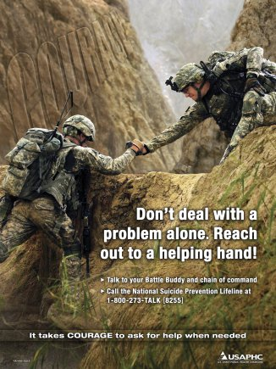
ACE-SI
Terminal Learning Objectives (TLOs)
Identify the problem and impact of suicide in the Army and your role as a leader in preventing suicide.
Identify suicide risk factors and protective factors, and identify stigma that may prevent Soldiers from seeking help when needed.
Demonstrate your ability to identify risk and intervene when a Soldier exhibits the warning signs of suicide.
Select the appropriate resource to use based on risk, warning signs, and in response to a suicide or suicide attempt.
2
Notes:
Directions: Display slide as you discuss the following talking points. Read the Example Speaker’s Notes for ideas on how to talk about this.
Talking Points:
ACE-SI discusses in more depth risk factors, protective factors, warning signs, and stigma as it relates to suicide intervention than annual ACE training.
This training is currently only required once in a Soldier’s or Army Civilian’s career.
We will be using what you have learned in your annual ACE training today during this course.
Please look at your ACE card that you have at your table and briefly go over Ask, Care, and Escort.
ACE-SI helps you recognize risk factors, protective factors, warning signs, and stigma in your Soldiers that you lead and serve with.
ACE-SI encourages you to take action in reducing risk factors, increasing protective factors, decrease stigma and intervene when you recognize warning signs in Soldiers and Army Civilians.
Make sure you know where to get help for your Soldiers and take early action to prevent Soldiers problems from developing into warning signs.
The most at-risk demographic is young Soldiers—Currently Soldiers from 18 to 24.

Slide 3
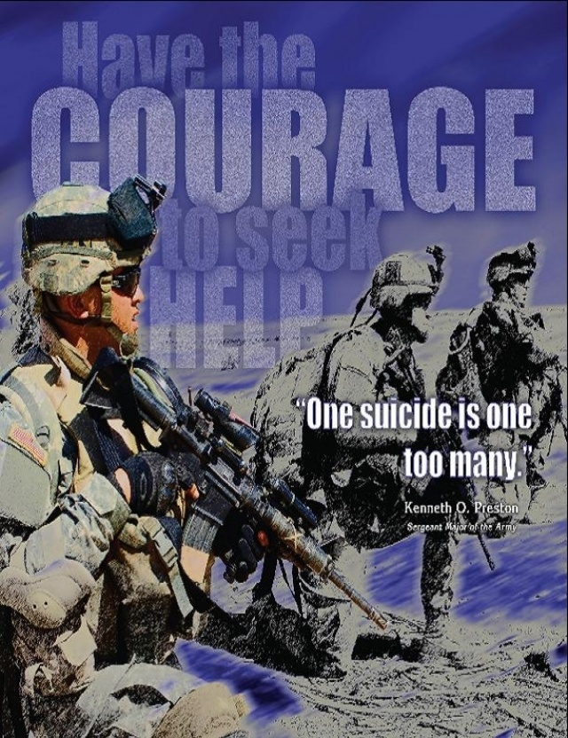
ACE-SI
How ACE-SI Course Works
Small groups do exercises.
Leader/recorder keeps group on task, records results, speaks for the group.
Timekeeper ensures all tasks are. completed in allotted time.
Roles change after each exercise.
Training facilitators work with all groups during exercises.
3
Notes:
Directions: Display slide as you discuss the following talking points. Read the Example Speaker’s Notes for ideas on how to talk about this.
Have each group choose a leader/recorder and a timekeeper for the first exercise/discussion. Answer any questions.
Talking Points:
Most work will be done in small groups.
Each group chooses leader/recorder and timekeeper for first exercise.
Leader/recorder and timekeeper roles change after each exercise. The leader and timekeeper roles will change by rotating to the right within each group.
Leader/recorder makes sure all participate, keeps team on task, and records bullets to share with other groups.
Timekeeper makes sure all work gets done in allotted time.
Facilitators will walk around during the exercises to work with the groups to facilitate discussion within the groups.
Questions about how this will work?

Slide 4
ACE-SI Lesson One
Sergeant Major of the Army
Reach for Help, I Did
4
Notes:
Directions: Play the video of Sergeant Major of the Army Raymond Chandler by clicking on the video embedded in the slide.
After the video ends discuss the following talking points. Read the Example Speaker’s Notes for ideas on how to talk about this.
Talking Points:
SMA Chandler found that his service experience in Iraq impacted his family and his job performance, and therefore sought behavioral health help.
It takes courage to ask for help.
Army is working to remove the stigma related to Soldiers and Army Civilians seeking behavioral mental health assistance or other assistance with issues.
Seeking help need not affect your career.
Asking for help when it is needed can prevent suicide.

Slide 5
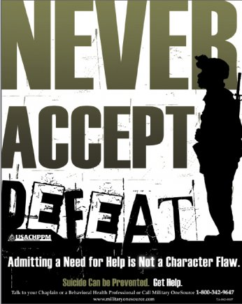
ACE-SI
Lesson One
Enabling Learning Objectives (ELOs)
Describe the impact of suicide on Soldiers, Families, your unit, and the Army.
List what the Army or your unit is doing to prevent suicides.
Describe the role of first line leaders in helping to prevent suicides in the Army.
5
Notes:
Directions: Direct attention to the learning objectives on the slide but do not read them. See the Example Speaker’s Notes for further information.
Talking Points:
Impact of suicide.
Army efforts to prevent suicide.
First line leader’s role.

Slide 6
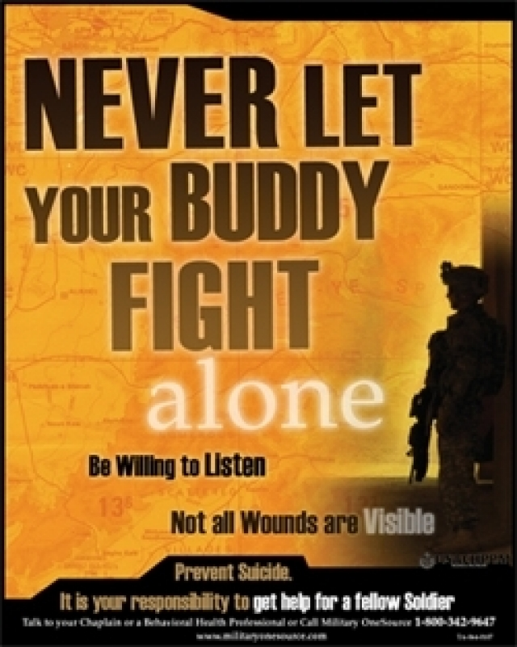
ACE-SI
Impact of Suicide
(Exercise 1, 5 min)
List three or more ways suicide affects Family members and friends of the person who died.
List at least three ways suicide impacts the mission and readiness of units.
List at least three ways suicide affects the effectiveness of fellow Soldiers?
6
Notes:
Directions: Direct attention to the questions on slide. Verbally assign one of the tasks to each small group. This is exercise 1. Allow 5 minutes for the discussion then call on each group to provide their top 3 answers to the class and discuss them with the class. Make notes on scratch paper. Read the Example Speaker’s Notes for ideas on how to talk about this.
Talking Points:
Every suicide is a tragedy.
Assign one question to each group.
Give directions for discussing and then reporting.
Discuss the key points from the Speaker’s Notes when the groups brief their answers.
Remind them of their roles.
Use note paper to record your answers.

Slide 7
322
301
We lost more Soldiers to suicide EVERY YEAR…..from 2003 to 2013…
than we did EVERY YEAR in Afghanistan
for 10 years
305
283
As of
1/7/14
242
201
180
135
97
111
85
2003 2004 2005 2006 2007 2008 2009 2010 2011 2012 2013
7
Notes:
Directions: Display slide as you discuss the following talking points. This slide may be briefed/discussed at this point in the class or after Slide Nine (9). It is up to the facilitator’s discretion on when to present this slide. Read the Example Speaker’s Notes for ideas on how to talk about this.
Talking Points:
What operational impact does Suicide have on the Army?
Allow time for answers from the class.
Suicide has become our most deadly enemy.
Suicide impacts Families, friends, co-workers, fellow Soldiers, units, leaders, morale, readiness, and the operational strength of the Army.
From 2003 through the third quarter of 2013, the Army lost the equivalent of 60 platoons or 2 Brigade Combat Teams (BCTs)
We must fight suicide just as we fight any other enemy.

Slide 8
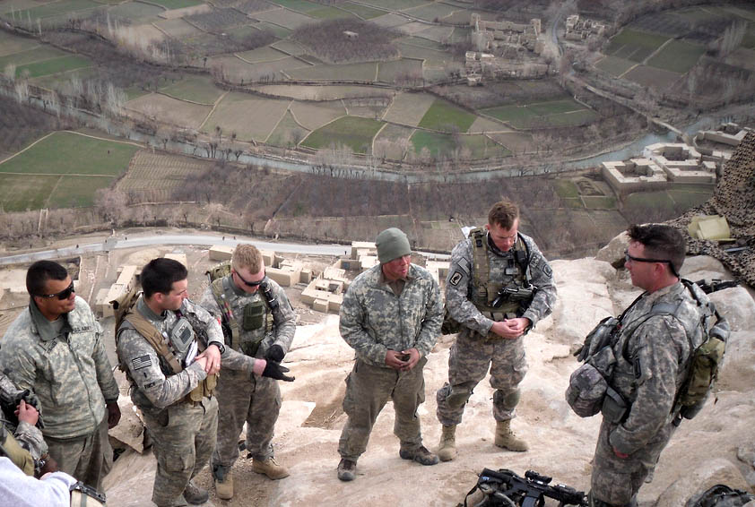
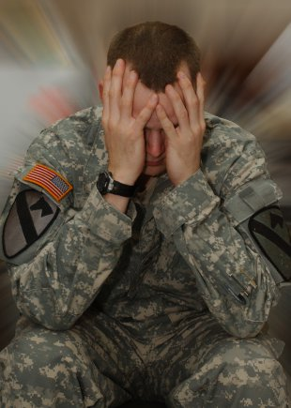
ACE-SI
Preventing Suicide
(Exercise 2, 5 min)
Describe at least five efforts the Army is doing to promote suicide prevention.
Describe at least five efforts your unit is doing to promote suicide prevention.
Describe at least three things you as junior leaders and first line supervisors can do to prevent suicides, specifically in your unit or organization.
8
Notes:
Directions: Direct attention to the questions on slide. Verbally assign one of the tasks to each small group. This is exercise 2. (Allow 5 minutes for the discussion then call on each group to provide their top 5 answers to the class.) Make notes on scratch paper. Read the Example Speaker’s Notes for ideas on how to talk about this. Have the groups brief their top three answers and discuss those answers with the overall class.
Talking Points:
Each group will answer all one the questions.
Assign one question to each group.
Each group should record their answers for their assigned question.
Discuss the key points from the Speakers Notes when the groups brief their answers.
Provide any additional information that the groups miss.

Slide 9
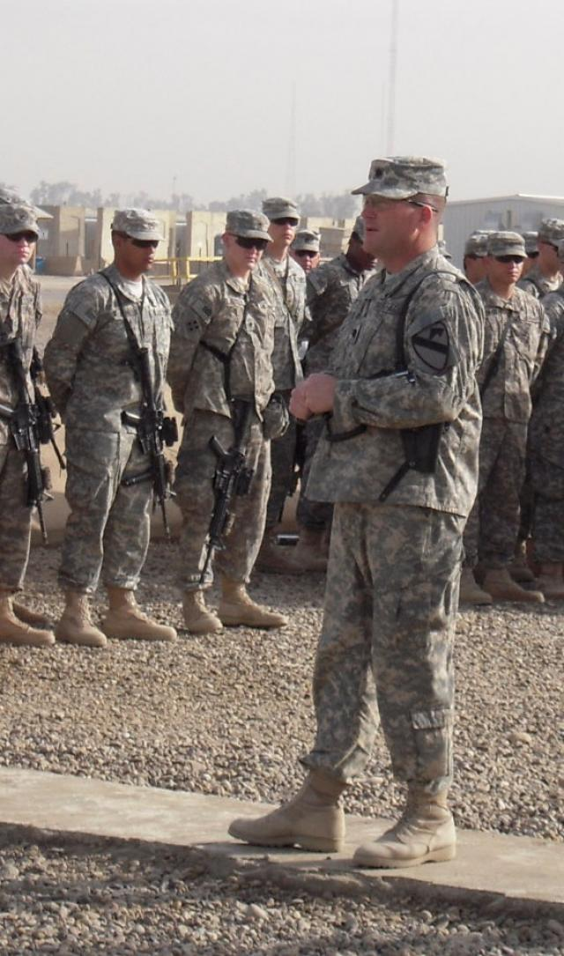
ACE-SI
What can junior leaders and first line supervisors do to prevent suicide?
Know your Soldiers so you know when behavior changes.
Create a climate to encourage asking for help if needed.
Encourage peer support (Battle Buddy).
Help all your Soldiers integrate into the unit/organization.
9
Notes:
Directions: Display slide as you discuss the following talking points. Read the Example Speaker’s Notes for ideas on how to talk about this. This slide allows you to summarize most of the information that was discussed in the two previous exercises. The key point to emphasize is that preventive action of the front line leaders will help a Soldier or Army Civilian reduce risk factors and increase their coping skills (protective factors).
Talking Points:
First line leaders are closest to the 18-24 year olds who are most at-risk.
You have to know your Soldiers to know when behavior has changed.
Talking to your Soldiers routinely makes it easier to ask hard questions.
Create a climate that encourages asking for help if you need it.
Encourage unit members to watch out for each other.
Help people who are isolated, new to the unit, or finding it hard to fit in.
You as a first line leader need to assist and follow up with Soldiers in dealing with their work and personal stress issues.

Slide 10
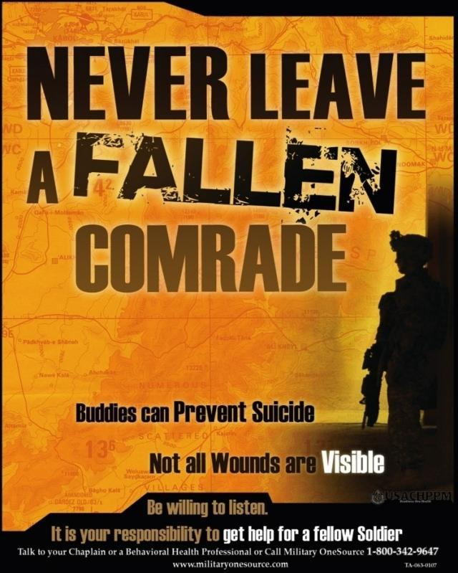
ACE-SI:
In this Lesson you have
Described the impact of suicide on Soldiers, Families, your unit, and the Army.
Listed what the Army or your unit is doing to prevent suicides.
Described the role of first line leaders in helping to prevent suicides in the Army.
10
Notes:
Directions: Display slide and summarize what they have learned in this lesson.
Talking Points:
Slide shows what we have done in this lesson.
Any questions?

Slide 11
ACE-SI
TEN MINUTE BREAK
Any Questions?
Talk to a Facilitator during the break.
U. S. Army Suicide Prevention Website:
www.preventsuicide.army.mil
Military Crisis Line (National Suicide Prevention Lifeline)
800-273-TALK (8255) press 1
(text 838255)
www.veteranscrisisline.net (online chat)
11
Notes:
Directions: Give the participants a 10 minute break, remind them of the time to return,
state again that no one should completely leave the training without talking to one of the facilitators.
Talking Points:
10 minute break.
Be back in the room by _______.
Do not leave the training without talking to a facilitator.

Slide 12
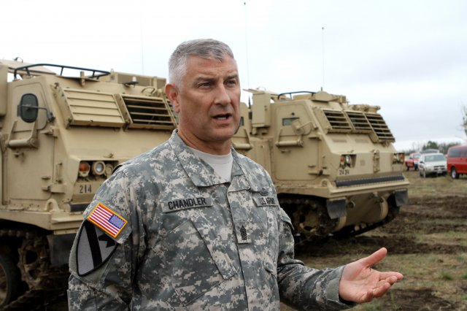
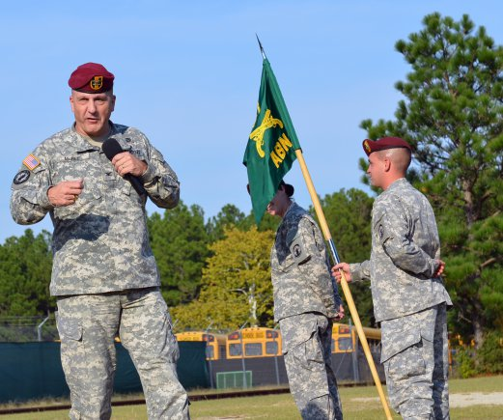
ACE-SI
Lesson Two
Enabling Learning Objectives (ELOs)
Identify risk factors that may increase the likelihood of suicide for an individual.
Identify protective factors that make it less likely a Soldier will die by suicide.
Identify stigma that may increase the likelihood that a Soldier or Army Civilian will not seek help.
Demonstrate an understanding of risk and protective factors, warning signs, and stigma.
12
Notes:
Directions: Ask each group to select a new leader/recorder and a new timekeeper. Direct attention to the words on the slide but do not read them.
Point out the that the Handout contains the definitions for “Risk Factors,” Protective Factors,” “Warning Signs,” and “Stigma. ”
Talking Points:
Please look at the learning objectives on the slide.
For Lesson 2 we will be working in our groups.
Each group should select a new leader/recorder and a new timekeeper now.
Note the definitions of risk and protective factors, stigma, and warning signs in the handouts.
Warning signs, risk factors and protective factors apply to Soldiers, Army Civilians and Family members.

Slide 13
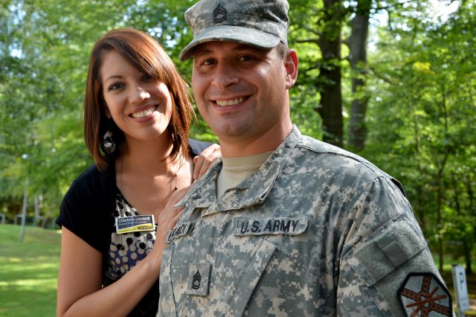
ACE-SI:
Risk Factors, Protective Factors, & Warning Signs (Applies to Soldiers & Civilians)
Risk Factors: refer to an individual's characteristics, circumstances, history and experiences
that raise the risk for suicide. Experiencing one of these does not necessarily mean that a person is contemplating suicide or self-harm.
Protective (Resilience) Factors: are skills, strengths, or resources that help people deal more effectively with stressful events. Protective factors enhance resilience and help to counterbalance risk factors (negative life events such as academic, occupational, or social pressures). Protective factors may be personal, external, or environmental. Protective factors reduce an individuals likelihood of suicide.
Warning Sign: It is often associated with a severe crisis that does not go away, that may worsen over time, or that may appear hopeless. Friends or loved ones in crisis may show signs that indicate that they are at immediate risk of attempting or dying by suicide. While some suicides occur without any obvious warning, most individuals considering suicide do give warning signs.
13
Notes:
Directions: Before displaying slide, ask for call outs from all the groups on what they believe a risk factor, protective factor, and warning sign is. Point out the definitions on the slide and in the handouts. These definitions should be used in the exercises as needed.
Talking Points:
Definitions on screen and in handouts.
Risk and Warning signs may sometimes overlap but warning signs indicate imminent danger of suicide.
The exercise will give you practice identifying these.
Everyone has risk in their lives, but not everyone will think about suicide.
Warning signs, risk factors and protective factors apply to Soldiers, Army Civilians and Family members.

Slide 14
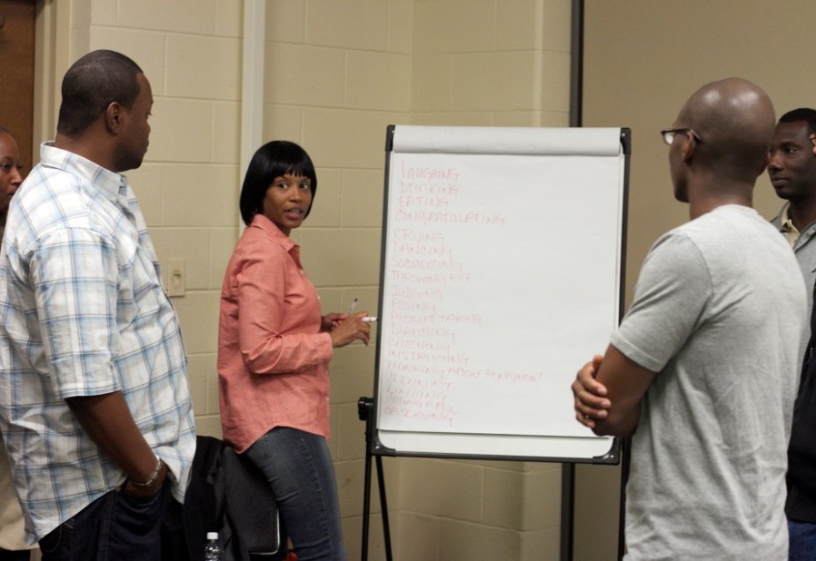
ACE-SI:
Examples of Risk Factors & Protective Factors
Risk Factors
Failed relationship
Family history of suicide
Prior suicide attempt
Mood disorders
Drug/Alcohol abuse
Access to lethal means
Financial stress
Legal (UCMJ/Non-Judicial) issues
Protective Factors
Connectedness (Family, friends, organization)
Faith
Availability of physical & behavioral health care
Coping ability
Participation in unit/group activities
Help seeking behavior
14
Notes:
Directions: Briefly discuss the various examples as how they relate to the definitions given previously while displaying slide. If time permits discuss the examples with the class by asking one or more of the groups if they have anything to add or if they have questions. Use the Example Speaker’s Notes for additional ideas.
Talking Points:
They have the definitions in their handouts for Risk Factors and Protective Factors.
Any disagreement about what is or is not a risk factor or protective factor?
Look at the definitions if necessary.
Everyone has risk in their lives, but not everyone will think about suicide.
Use the definitions and these examples to assist you in the upcoming exercises.
Point out that warning signs, risk factors and protective factors are the same for Soldiers, Army Civilians and Family members.

Slide 15
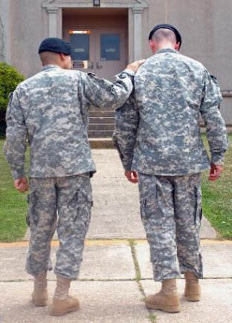
ACE-SI:
Stigma (Applies to Soldiers and Civilians)
Stigma:
The perception among leaders and Soldiers that help-seeking behavior will either be detrimental to their career (e.g. prejudicial to promotion or selection to leadership positions) or that it will reduce their social status among their peers.
Actions that can result from or cause stigma:
Excluding people (avoiding them)/isolating people (shunning them or omitting them from group activities).
Laughing at people.
Picking on people or making them scapegoats for the group.
14
Notes:
Directions: Display this slide and discuss the definition of Stigma and actions that can result from or cause stigma. Use your Example Speaker’s Notes for ideas.
Talking Points:
Think about stigma that you may have encountered or seen in the past.
How should a leader respond to stigma?
It takes courage to ask for help.
Remember the SMA’s video.

Slide 16
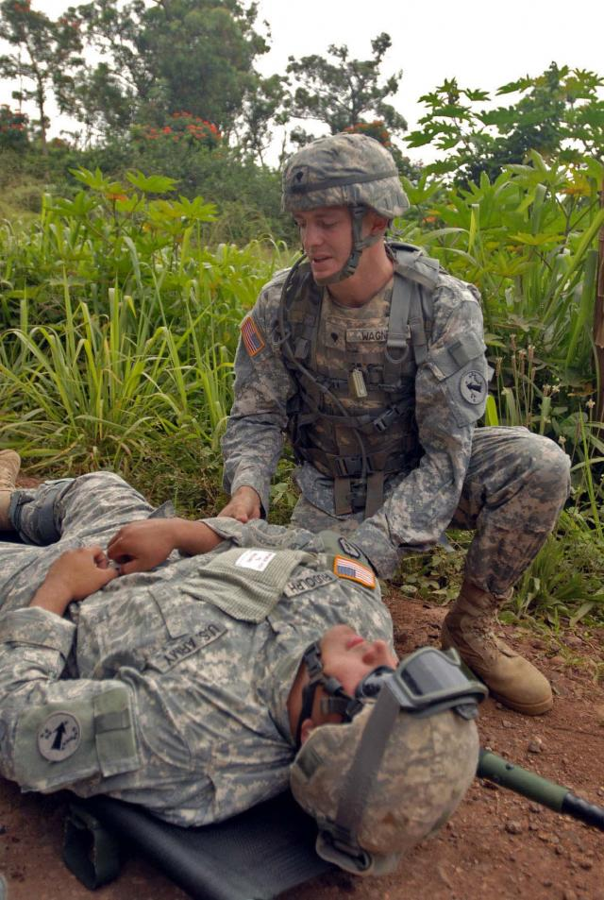
ACE-SI: Risk Factors, Protective Factors, and Stigma (Exercise 3, 10 min, AC)
You are a first line leader stationed at Ft. Stewart, GA.
Your unit completed 9 month deployment in
Afghanistan 2 yrs ago.
16% of Soldiers now assigned did not deploy with your unit.
You are now at Fort Drum, NY for training.
Review the background quad chart for scenario information and assess each Soldier for Risk Factors, Protective Factors, Warning Signs, and Stigma.
16 AC
Notes:
Directions: The purpose of this exercise is to get everyone familiar with the fictionalized characters in the scenario and their background. Describe the information on the slide to the trainees then tell them to look in their handouts for Exercise 3 and review the quad chart to identify Risk Factors, Protective Factors, Warnings Signs, and Stigma. Use the Active component (AC) slide and handouts (Appendix D has AC handouts) for predominantly active component students, and the RC slide and handouts for Reserve/National Guard component students (Appendix E contains the RC handouts). Direct everyone to begin work, but remind them that this is an individual exercise. Then select some individuals from the groups to report out on the three soldiers and have a brief discussion.
Talking Points:
Read the paragraph that sets the scene.
Each individual within each group will read the entire Exercise 3 Quad Chart so that they are familiar with all the characters.
Every individual in each group will execute a detailed review of each character in the exercise and mark up their Quad Chart.
Point out that protective factors, risk factors and warning signs are the same for Soldiers, Army Civilians and Family members.
You have 5 minutes to conduct this exercise before reporting out your findings.
Groups should begin work now.

Slide 17
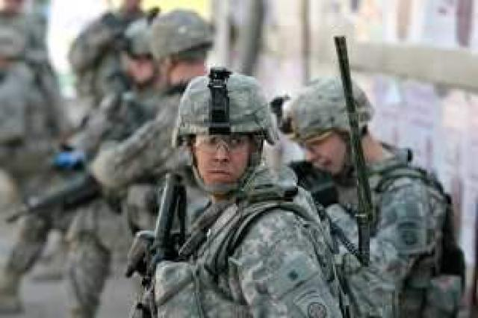
ACE-SI: Risk Factors, Protective Factors, and Stigma (Exercise 3 Background, 10 min, RC)
You are a first line leader in a Reserve Component Quartermaster Company. Your home station is Independence, KS.
Your unit deployed to Afghanistan two years ago.
24% of your unit didn’t deploy with your unit.
Many of your Soldiers do not live in the Independence area; you see your Soldiers once a month, so you communicate by phone, email, text, Facebook, etc.
Review the background quad chart for scenario information and assess each Soldier for Risk Factors, Protective Factors, Warning Signs, and Stigma.
16 RC
Notes:
Directions: The purpose of this exercise is to get everyone familiar with the fictionalized characters in the scenario and their background. Describe the information on the slide to the trainees then tell them to look in their handouts for Exercise 3 and review the quad chart to identify Risk Factors, Protective Factors, Warnings Signs, and Stigma. Use the Active component (AC) slide and handouts (Appendix D has AC handouts) for predominantly active component students, and the RC slide and handouts for Reserve/National Guard component students (Appendix E contains the RC handouts). Direct everyone to begin work, but remind them that this is an individual exercise. Then select some individuals from the groups to report out on the three soldiers and have a brief discussion.
Talking Points:
Read the paragraph that sets the scene.
Each individual within each group will read the entire Exercise 3 Quad Chart so that they are familiar with all the characters.
Every individual in each group will execute a detailed review of each character in the exercise and mark up their Quad Chart.
Point out that protective factors, risk factors and warning signs are the same for Soldiers, Army Civilians and Family members.
You have 5 minutes to conduct this exercise before reporting out your findings.
Groups should begin work now.

Slide 18
ACE-SI:
Risk Factors, Protective Factors, & Warning Signs (Applies to Soldiers & Civilians)
Risk Factors: refer to an individual's characteristics, circumstances, history and experiences
that raise the risk for suicide. Experiencing one of these does not necessarily mean that a person is contemplating suicide or self-harm.
Protective (Resilience) Factors: are skills, strengths, or resources that help people deal more effectively with stressful events. Protective factors enhance resilience and help to counterbalance risk factors (negative life events such as academic, occupational, or social pressures). Protective factors may be personal, external, or environmental. Protective factors reduce an individuals likelihood of suicide.
Warning Sign: It is often associated with a severe crisis that does not go away, that may worsen over time, or that may appear hopeless. Friends or loved ones in crisis may show signs that indicate that they are at immediate risk of attempting or dying by suicide. While some suicides occur without any obvious warning, most individuals considering suicide do give warning signs.
17
Notes:
Directions: Display this slide while the trainees are working on Exercise 3. Point out that the definitions are also in the handouts that they received for use in the course.
Talking Points:
These definitions are provided for your review while working the Exercise.
Remember you have the definitions of risk factors, protective factors, stigma, and warning signs in your handouts.

Slide 19
ACE-SI Group Exercise Record Form
Character Name: . Group Name: . Date: .
ACE-SI
Group Exercise Record
Form
 | Exercise #4 | Exercise #5
Protective Factors
Risk Factors
Warning Signs
Stigma Issues
Leader Actions: your assessment; COAs; and resources
18
Notes:
Directions: Explain the Group Exercise Record Form using the talking points and explain how it will be used for Exercises 4, and 5. See Example Speaker’s Notes for suggestions.
Talking Points:
In Exercise 4 and 5 you will become more familiar with the three fictionalized characters that are a part of a unit and you will use this form to record your assessment.
Your role is as a first line leader in that unit of those soldiers.
You will organize your group so that 2 to 3 members of your group will focus on each soldier, but each member of the group will read the entire exercise to be familiar with each soldier.
Read the exercises.
Talk to each other to come up with answers to the questions on the form.
There are no “right” and “wrong” answers.
Select a new Leaders/recorder—each (2-3 person) sub-group will record their answers on the Group Exercise Record form for their Soldier.
Select a new Timekeeper; keep your group on task to be ready to report out in the time allotted for each exercise.

Slide 20
ACE-SI: Risk Factors, Protective Factors, and Stigma (Exercise 4, 15 min, AC)
You are a first line leader & stationed at Ft. Stewart, GA.
Completed 9 month deployment in Afghanistan 2 yrs
ago.
At a Winter Mission Readiness Exercise (MRE) at Ft Drum, NY.
Your unit was slated for a future deployment rotation to South Korea and is now at Ft Drum for a MRE.
Your Platoon Leader is well respected by the Battalion Commander. She has deployment experience as well and you value her advice.
Morale improving except for a couple of Soldiers.
19 AC
Notes:
Directions: Describe the information on the slide to the students then tell them to look in their handouts for Exercise 4 and the Group Record Exercise Form. Direct the groups to begin work. Use the Active component (AC) slide for predominantly active component students and the RC slide for Reserve/National Guard component students (Appendix E has RC material handouts). Note: The RC slide is the next slide in the presentation and is hidden. If you are facilitating RC students please hide the AC slide and unhide the RC slide. Mention during the out brief discussion concerning the Platoon Leader that training participants need look at what their actions would be if they were the Platoon Sergeant.
Talking Points:
Describe the bullet points on the slide that sets the scene, and have the students read the paragraph on the Quad chart.
The group will read the entire exercise scenario so that they are familiar with all the characters.
Each group will break up so that two to three group members are assigned to execute a detailed review of each character in the exercise and record their findings on the Group Exercise Record form.
Point out that warning signs, risk factors and protective factors are the same for Soldiers, Army Civilians and Family members.
You have 15 minutes to conduct this exercise.
Group should begin work now.

Slide 21
ACE-SI: Risk Factors, Protective Factors, and Stigma (Exercise 4, 15 min, RC)
Reduced funding results in classroom training. Lack of repair parts and transportation funds has delayed the return of much of your equipment.
The last drill indicates unit morale has dropped.
Your new Battalion Commander made an
unexpected visit and is disappointed in the quality of
training.
LT Freeland, your Platoon Leader is well respected by the unit. She has deployment experience as well and you value her advice.
19 RC
Notes:
Directions: Describe the information on the slide to the students then tell them to look in their handout for Exercise 4 and the Group Record Exercise Form. Direct the groups to begin work. Use the Active component (AC) slide for predominantly active component students, and the RC slide for Reserve/National Guard component students (Appendix E has RC material). Note: If you are facilitating RC students please hide the AC slide and unhide this RC slide.
Talking Points:
Facilitator describe the bullet points on the slide that sets the scene, and have the students read the paragraph on the Quad chart.
The group will read the entire exercise scenario so that they are familiar with all the characters.
Each group will break up so that two to three groups members are assigned to execute a detailed review of each character in the exercise and record. their findings on the group exercise form.
Point out that warning signs, risk factors and protective factors are the same for Soldiers, Army Civilians and Family members.
Group should begin work now.
You have 15 minutes to conduct this exercise.

Slide 22
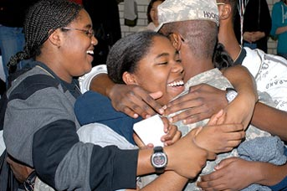
ACE-SI:
Examples of Risk Factors & Protective Factors
Risk Factors
Failed relationship
Family history of suicide
Prior suicide attempt
Depression/Mood disorders
Drug/Alcohol abuse
Access to lethal means
Financial stress
Legal (UCMJ/Non-Judicial)
Protective Factors
Connectedness (family, friends, organization)
Faith
Availability of physical & behavioral health care
Coping ability
Participation in unit/group activities
Help seeking behavior
20
Notes:
Directions: This slide is to be shown while the groups are working on their solutions to Exercise 4 so that they have examples available to assist them in identifying the various Risk Factors and Protective Factors. Also, it should be shown while discussing the Exercise solutions during the group and class discussion. When the discussion switches to Stigma go forward to the next slide on Stigma. See the Example Speaker’s Notes for ideas on handling discussions and group answers.
Talking Points:
These examples are provided for your review while working the Exercise.
Remember you have the definitions of risk factors, protective factors, and warning signs in your handouts.

Slide 23
ACE-SI:
Stigma (Applies to Soldiers and Civilians)
Stigma:
The perception among leaders and Soldiers that help-seeking behavior will either be detrimental to their career (e.g. prejudicial to promotion or selection to leadership positions) or that it will reduce their social status among their peers.
Actions that can result from or cause stigma:
Excluding people (avoiding them)/isolating people (shunning them or omitting them from group activities).
Laughing at people.
Picking on people or making them scapegoats for the group.
21
Notes:
Directions: This slide is to be shown while the groups are working on their solutions to Exercise 4 so that they have examples available to assist them in identifying the various stigma issues that may be present in the scenario. Also, it should be shown while discussing the exercise solutions during the group and class discussion.
Talking Points:
These examples are provided for your review while working Exercise 4.
Remember you have the definitions of risk factors, protective factors, stigma, and warning signs in your handouts.

Slide 24
ACE-SI:
In this Lesson you have
Identified protective factors that make it less likely a Soldier will die by suicide.
Identified risk factors that may increase the likelihood of suicide for an individual.
Identified stigma that may increase the likelihood that a Soldier or Army Civilian will not seek help.
Demonstrated an understanding of risk, protective factors, warning signs and stigma.
22
Notes:
Directions: Briefly indicate that these are the ELOs that were covered in Lesson 2.
Talking Points:
Slide shows what we have done in this lesson.
In our next lesson, we will meet our characters again and learn more about them.
Any questions?

Slide 25
ACE-SI
TEN MINUTE BREAK
Any Questions?
Talk to a Facilitator during the break.
U. S. Army Suicide Prevention Website:
www.preventsuicide.army.mil
Military Crisis Line (National Suicide Prevention Lifeline)
800-273-TALK (8255) press 1
(text 838255)
www.veteranscrisisline.net (online chat)
23
Notes:
Directions: Give the participants a 10 minute break, remind them of the time to return,
state again that no one should completely leave the training without talking to one of the facilitators.
Talking Points:
10 minute break.
Be back in the room by _______.
Do not leave the training without talking to a facilitator.

Slide 26
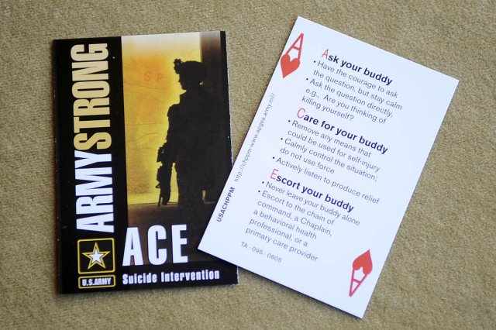
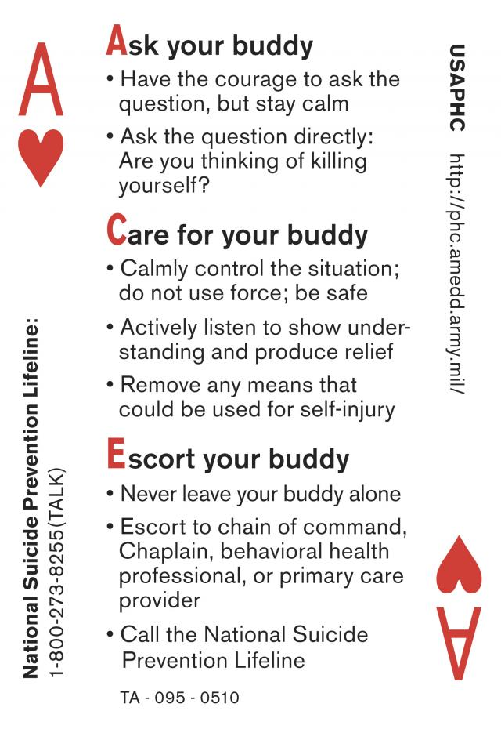
ACE-SI
Lesson Three
Enabling Learning Objectives (ELOs)
Distinguish between risk factors and the warning signs that signal immediate danger.
Discuss effective communications techniques when intervening with Soldiers using Ask, Care, Escort as an immediate action drill.
Conduct an intervention Role Play using Ask, Care, Escort as an immediate action drill.
Describe appropriate actions a leader should take when presented with specific warnings signs that require immediate action.
24
Notes:
Directions: Briefly discuss the ELO’s for Lesson 3. Ask each group to select a new leader/recorder and a new timekeeper. Direct attention to the words on the slide but do not read them. Again point out that the Handout contain the definitions of Risk Factors, Protective Factors, Warning Signs, and Stigma.
Talking Points:
Please look at the learning objectives on the slide.
For Lesson 3 we will be working in our small groups.
Each group should select a new leader/recorder and a new timekeeper now.
Remember you have definitions and an ACE card.
We will briefly review the Ask, Care, Escort immediate action drill that was covered in your annual ACE training.

Slide 27
ACE-SI Lesson Three
Ask, Care, and Escort
25
Notes:
Directions: Play the video of the ACE method of suicide intervention by clicking on the video embedded in the slide. After the video ends discuss the following talking points. Look at the Example Speaker’s Notes for suggestion on how to talk about this.
Talking Points:
This video clip talks about the ACE method of suicide prevention.
ACE means Ask, Care, Escort.
Emphasize that the purpose of ACE-SI is for you to be able to ASK this SPECIFC QUESTION!!! “Are you thinking of killing yourself?” If the answer is “yes”, then you have to conduct a suicide intervention. If “no” then take appropriate troop leading actions to help the Soldier or Army Civilian.
ACE training is available for Soldiers, Leaders, Army Civilians, and for Family Members. ACE for Army Civilians is also available as online training.
Remember that ESCORT does not mean Transport. If the person requiring Escort has ingested Medication and/or Alcohol then you need to call 911. Do not drive the person yourself. You cannot do CPR while driving. Let the experts help.
Remember the ACE method as we do the next two exercises

Slide 28
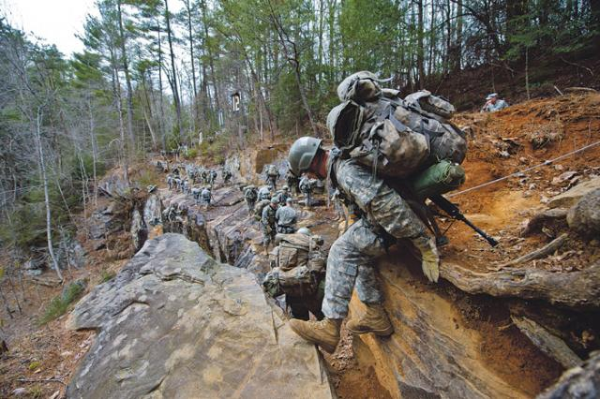
ACE-SI:
Risk Factors vs. Warning Signs
Risk factors may increase a person’s risk of suicide.
Warning signs are actions, changes in behavior, or changes in mood that may indicate that a person is planning to die by suicide.
A medical example* of risk factors & warning signs helps us tell them apart:
High blood pressure is a RISK FACTOR for heart attack.
Chest pains are a WARNING SIGN of heart attack that requires immediate action.
* Suicide Prevention Resource Center, & Rodgers, P. (2011). Understanding risk and protective factors for suicide: A primer for preventing suicide. Newton, MA: Education Development Center, Inc.
26
Notes:
Directions: Show slide as you discuss the following talking points. Look at the suggested Example Speaker’s Notes for discussion suggestions.
Talking Points:
Discuss the difference between risk factors and warning signs.

Slide 29
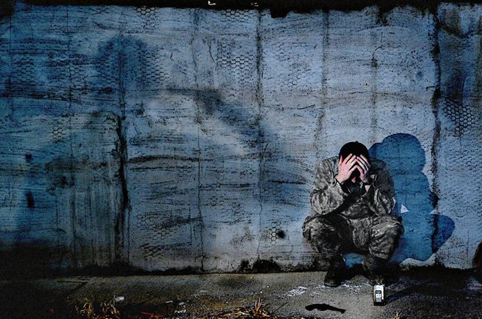
ACE-SI:
Examples of Warning Signs
Talking about hurting or killing oneself
Obsession with death
Noticeable changes in eating/sleeping habits
Mood changes; hopelessness, rage, anxiety
Feeling trapped, no way out; no reason to live
Increasing alcohol or drug use
Isolation—withdrawing from Family & friends
Giving away possessions
Reckless and risky activities
27
Notes:
Directions: Direct attention to slide as you discusses the following talking points. Read the Example Speaker’s Notes for ideas on how to talk about this.
Talking Points:
Examples of warning signs.
Changes in behavior require investigation and MAY require immediate action.
Threats of suicide and other warning signs require immediate action.

Slide 30
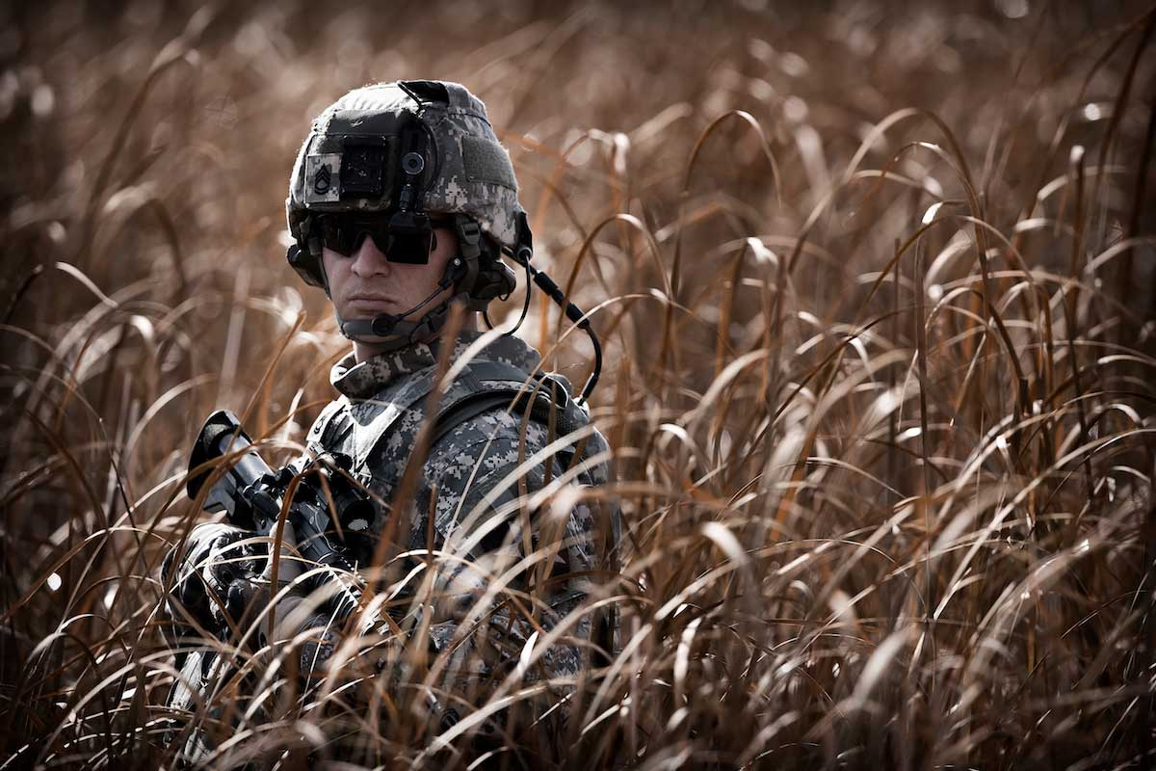
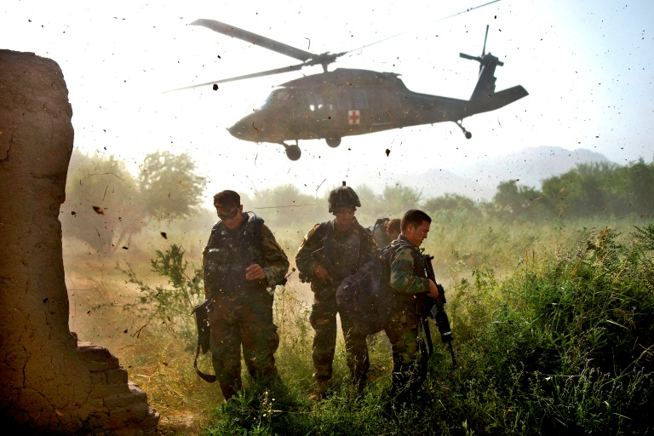
ACE-SI: Risk Factors, Protective Factors, and Warning Signs (Exercise 5, 15min, AC)
After the MRE, your unit is directed to stand down from planned deployment. A month later, your unit is deployed on short notice to support recovery efforts in Japan following a severe earthquake and tsunami killing an estimated 15,000 Japanese.
Recovery operations deployment will last 2 to 4 months.
Missions focus on providing key site security, NGO convoy & humanitarian assistance security & support, establishing secure refugee sites, and restoring essential services.
Situation is very bad. Your unit is tasked with human remains recovery efforts—a gruesome task for which no one has received any training or instruction.
28 AC
Notes:
Directions: Read slide to the students then hand out one copy of Exercise 5 for each person and three or more copies of the Group Exercise Record Form to each group. Use the Active component (AC) slide and materials for predominantly active component students, and the RC slide and materials for Reserve/National Guard component students (Appendix E has RC material). Direct the groups to begin work. Note: During this group exercise display the “Examples of Warnings Signs” slide for the students to be able to reference as they work. Mention during the out brief discussion concerning the Platoon Leader that training participants need look at what their actions would be if they were the Platoon Sergeant.
Talking Points:
We have talked already about how to use the Group Exercise Record Form.
Read the slide paragraph which sets the scene
The group will read the entire exercise scenario so that they are familiar with all the characters.
Each group will break up so that two or three group members are assigned to execute a detailed review of their previously assigned character in the exercise and record their findings on the Group Exercise Record Form.
Remind the students that they may use their Handouts which have the definitions of Risk Factors, Protective Factors, and Warning Signs.
Group should begin work now and you have 15 minutes to complete the exercise.

Slide 31
ACE-SI: Risk Factors, Protective Factors, and Warning Signs (Exercise 5, 15min, RC)
You are at home station.
Your unit received an Alert Order for a 90 day deployment to Japan and is scheduled to depart in one month to support recovery efforts in Japan following a severe earthquake and tsunami killing an estimated 15,000 Japanese.
Missions focus will be supporting long term recovery operations.
The battalion has adopted the supply and haul mission idea; and assigned LT Freeland as the BN project officer.
The supply and haul training is demanding, rewarding, and prepares them for the mission in Japan.
28 RC
Notes:
Directions: Review the slide with the students, then hand out one copy of Exercise 5 for each person and three copies of the Group Exercise Record Form to each group. Direct the groups to begin work. Use the Active component (AC) slide for predominantly active component students, and the RC slide for Reserve/National Guard component students (Appendix E has RC material). Note: During this group exercise display the “Examples of Warnings Signs” slide for the students to be able to reference as they work. Mention during the out brief discussion concerning the Platoon Leader you need look at what the actions would be if you were the Platoon Sergeant.
Talking Points:
We have talked already about how to use the Group Exercise Record Form.
Read the slide paragraph which sets the scene.
The group will read the entire exercise scenario so that they are familiar with all the characters.
Each group will break up so that two to three group members are assigned to execute a detailed review of each character in the exercise and record their findings on the group exercise form.
Remind the students that they may use their “Handout” which has the definitions of Risk Factors, Protective Factors, and Warning Signs.
Group should begin work now.
You may begin – you have 15 minutes to complete the exercise.

Slide 32
ACE-SI:
Examples of Warning Signs
Talking about hurting or killing oneself
Obsession with death
Noticeable changes in eating/sleeping habits
Mood changes; hopelessness, rage, anxiety
Feeling trapped, no way out; no reason to live
Increasing alcohol or drug use
Isolation—withdrawing from family & friends
Giving away possessions
Reckless and risky activities
29
Notes:
Directions: Display this slide as you have each group provides their assessment from Exercise 5. Discuss with the groups the risk factors, protective factors, warning signs, & stigma identified in Exercise 5 with this this slide displayed. Read the Example Speaker’s Notes for ideas on how to talk about this.
Talking Points:
These examples of warning signs are provided for your review while working the Exercise, but it is not a definitive list.
Remember you have the definition of warning signs in your handouts.
One point to keep in mind is that changes in behavior require investigation and MAY require immediate action.
During the discussion if any warning signs are discussed ask what actions would they execute as the first line leader for the Soldier?

Slide 33
ACE-SI:
Effective Communication
Pre-discussion / Rehearsal (practice ACE)
Means of Communicating
Rapport Building
Open-ended Questions
Active Listening
30
Notes:
Directions: Display slide as you discuss the following talking points. The main purpose of this slide is to discuss the information presented by the bullets on the slide. Briefly go over the ACE card and emphasize that Suicide Intervention is critical and that you must directly ask the question “Are you thinking of killing yourself?” or some version of that. Look at the Example Speaker’s Notes to see an example of how to talk about this.
Talking Points:
Choose a new leader/speaker and timekeeper
We value privacy and fear to intrude into other people’s business
Implementing ACE requires effective communication.
Point out the Do’s and Don’ts of Active Listening and how important it is to be an active and effective listener for your Soldiers and Civilians. Example Open ended questions vs. “Yes or No” questions.
Techniques of effective communication can help us use ACE to build rapport and correctly understand another person
Asking directly about suicide does not “suggest” the idea to people
Asking directly may give the person relief and show him or her that you care.

Slide 34
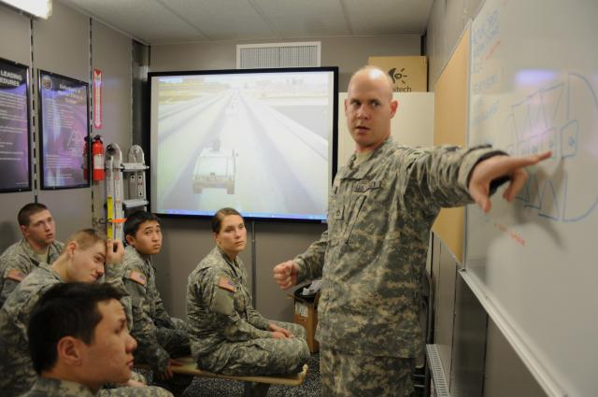
ACE-SI: Risk Factors, Protective Factors, Warning Signs, and Stigma (Role Play Exercise 6, 15 min, AC)
Returned from Japan four months ago, just in time for an intensive NTC prep and, then cancellation.
Soldiers are physically and mentally worn out, but proud of the difference they made in Japan.
Most Soldiers have reintegrated with families, many are having difficulties at home & in the community.
Soldiers adjusting to garrison life with reduced training funds and reduced funding in fuel, ammo,
& repair parts.
Training not challenging & limited to classrooms. Reduced funding, post support contracts are terminated. Performing installation duties such as mowing grass, painting rooms, etc.
31 AC
Notes:
Directions: Direct your attention to Exercise 6 in the handout. Do not use the Group Exercise Record Form for Exercise 6—they are not used in this exercise. Read the slide introduction to the exercise to “set the scene.” Ask the groups to read through the exercise as a group and then work in teams of two to do a role play. Use the Active component (AC) slide for predominantly active component students, and the RC slide for Reserve/National Guard component students (Appendix E has RC material).
For the role play, one member of the subgroup team of two should choose to play the role of one of the Soldiers while the other person plays the role of the first line leader of the unit and uses effective communication techniques and ACE to intervene. After they have completed the first role play the subgroup members switch roles and do the role play again. The role players will conduct a short 1 minute AAR of what occurred during the role play after each role play is completed.
Talking Points:
Divide up into teams of two within your groups.
For uneven numbers in a group, form one team of three.
Read the exercise.
Role play, using effective communication techniques and ACE.
We want them to ASK THE QUESTION!!! “Are you thinking of killing yourself?”
Take turns so everyone has a chance to role play.
Critique each other’s communication and offer suggestions.
Each role play should take about 3 or 4 minutes then change roles.

Slide 35
ACE-SI: Risk Factors, Protective Factors, Warning Signs, and Stigma (Role Play Exercise 6, 15 min, RC)
Returned from Japan four months ago.
Your unit was commended for the dignity and respect shown in handling the human remains.
Deployment caused significant hardships in the Soldier’s family lives and civilian jobs.
Soldiers assigned to human remains recovery seem
to show signs of post traumatic stress.
Lt Freeland requests counseling for these Soldiers but is reprimanded by the Battalion Commander.
31 RC
Notes:
Directions: Direct your attention to Exercise 6 in the handout. Do not use the Group Exercise Record Form for Exercise 6—they are not used in this exercise. Read the slide introduction to the exercise to “set the scene.” Ask the groups to read through the exercise as a group and then work in teams of two to do a role play. Use the Active component (AC) slide for predominantly active component students, and the RC slide for Reserve/National Guard component students (Appendix E has RC material).
For the role play, one member of the subgroup team of two should choose to play the role of one of the Soldiers while the other person plays the role of the first line leader of the unit and uses effective communication techniques and ACE to intervene. After they have completed the first role play the subgroup members switch roles and do the role play again. The role players will conduct a short 1 minute AAR of what occurred during the role play after each role play is completed.
Talking Points:
Divide up into teams of two within your groups.
For uneven numbers in a group, form one team of three.
Read the exercise.
Role play, using effective communication techniques and ACE.
We want them to ASK THE QUESTION!!! “Are you thinking of killing yourself?”
Take turns so everyone has a chance to role play.
Critique each other’s communication and offer suggestions.
Each role play should take about 3 or 4 minutes then change roles.

Slide 36
ACE-SI:
Effective Communication
Pre-discussion / Rehearsal (practice ACE)
Means of Communicating
Rapport Building
Open-ended Questions
Active Listening
30
Notes:
Directions: Display this slide as you have each group provides their assessment from Exercise 6. This slide is for the students reference during the execution of Exercise 6. Read the Example Speaker’s Notes for ideas on how to talk about this.
Talking Points:
These reminders of effective communication are provided for your review while working Exercise 6.
One point to keep in mind is that effective communication requires effective active listening.
During the exercise remember to ask the question “Are You Thinking of Killing Yourself?”

Slide 37
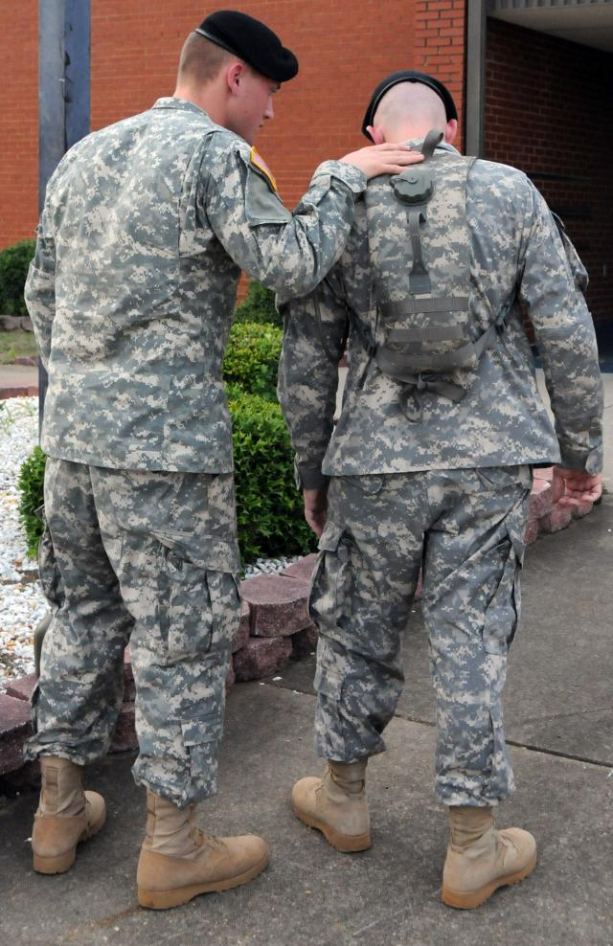
ACE-SI:
Actions a leader can take to prevent suicide
Was doing this role play hard for you? If so, why?
ACE method says that you stay with the person and never leave them alone. Why is that?
What follow up actions do you take after the Soldier has
received help?
32
Notes:
Directions: After allowing time for the role plays, show slide as you discuss the following talking points. Read the Example Speaker’s Notes to see an example of how to talk about this.
Talking Points:
Was the role play hard? Why?
How many actually asked “Are you thinking about killing yourself?” Show of hands.
Even though it is hard to ask these questions, if you are concerned, then ask very directly.
What follow up Leadership actions do you take after the Soldier has received help? Are his/her problems solved that caused the pain to begin with?
You may save a life!

Slide 38
ACE-SI:
In this Lesson you have
Distinguished between risk factors and the warning signs that signal immediate danger.
Discussed effective communications techniques when intervening with Soldiers using Ask, Care, Escort as an immediate action drill.
Conducted an intervention Role Play using Ask, Care, Escort as an immediate action drill.
Described appropriate actions a leader should take when presented with specific warnings signs that require immediate action.
33
Notes:
Directions: Display slide and summarize what they have learned in this lesson.
Talking Points:
Slide shows what we have done in this lesson.
In our next lesson, we will discuss resources available for Leaders to use to prevent suicide and assist Soldiers, Army Civilians, and Family members.
Any questions?

Slide 39
ACE-SI
TEN MINUTE BREAK
Any Questions?
Talk to a Facilitator during
the break.
U. S. Army Suicide Prevention Website:
www.preventsuicide.army.mil
Military Crisis Line (National Suicide Prevention Lifeline)
800-273-TALK (8255) press 1
(text 838255)
www.veteranscrisisline.net (online chat)
34
Notes:
Directions: Give the participants a 10 minute break, remind them of the time to return,
state again that no one should completely leave the training without talking to one of the facilitators.
Talking Points:
10 minute break.
Be back in the room by _______.
Do not leave the training without talking to a facilitator.

Slide 40
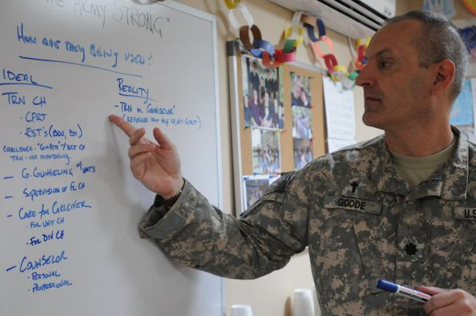
ACE-SI
Lesson Four
Enabling Learning Objectives (ELOs)
Describe differences between emergency resources and non-emergency resources.
Identify local suicide prevention resources.
Use mobile devices to explore designated suicide-related apps and websites.
Discuss appropriate postvention resources/actions to be used in the event of a suicide or suicide attempt.
35
Notes:
Directions: Direct attention to the learning objectives on the slide but do not read them. Use the talking points to discuss these. Read the Example Speaker's Notes in the Handbook for ideas on how to talk about this.
Talking Points:
Leaders need to know the difference between emergency & non-emergency resources and which apply to their Soldier’s situation (based on risk, warning signs, response to suicide or attempt etc.).
Leaders plan ahead for emergencies by having emergency resource information at their fingertips (i.e. Cell phone, Leaders Guide, etc.).
Leaders plan ahead to assist their soldiers by having non-emergency resources at their fingertips. The goal is be able to assist a Soldier with their issues/challenges quickly.
If you do not have a “Smartphone” buddy up with someone in your group.
Apps and installation websites can be useful resources.
Postvention is about what leaders should do if there is a suicide attempt or suicide in your unit/organization.

Slide 41
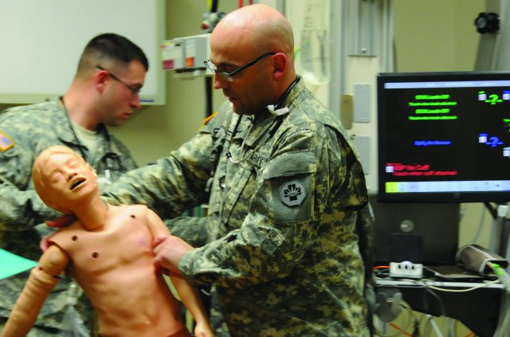
ACE-SI
Emergency Resources
(Exercise 7, 5 min.)
Local Emergency Resources (Dial 911)
Military Police/Civilian Police
Your chain of command
Hotlines--trained people 24/7/365
Military Crisis Line (National Suicide
Prevention Lifeline)
800-273-TALK (8255) press 1 ; Text 838255
Europe: 00800 1273 8255 or DSN 118
http://www.veteranscrisisline.net (online chat)
Korea Crisis Line 0808-555-118 or DSB 118
OEF Crisis Line
ROSHAN: 070-113-2000, wait for dial tone and dial 1-1-1; DSN 1-1-1
Service members can also receive support by e-mailing OEFCrisisHotline@afghan.swa.army.mil
36
Notes:
Directions: Ask the class to tell you the difference between an emergency and non-emergency resource and provide examples of each. Instruct class to examine the slide and the resource list provided by the SPPM (in handouts) to identify the name, address, and phone number of emergency resources. If mobile access is available they can also use mobile devices to locate local resources. (Direct attention to the Military Crisis Line number on the slide.) Ask for call outs to ensure only emergency resources have been chosen. Have the class program phone numbers into their phone contacts list and as a minimum they should program the Military Crisis Line phone number into their mobile device or copy the number to program in later. The facilitator will point out that Leaders plan ahead to deal with emergencies.
Talking Points:
Leaders plan ahead: identify local emergency resources (name, location, phone, and hours) to use for a suicide intervention.
Hotlines/Crisis Lines—confidential resources with trained people 24/7/365.
Military Crisis Line (National Suicide Prevention Lifeline).
OEF Crisis Line.
Put crisis line and your local emergency numbers into your cell phone contacts list.

Slide 42
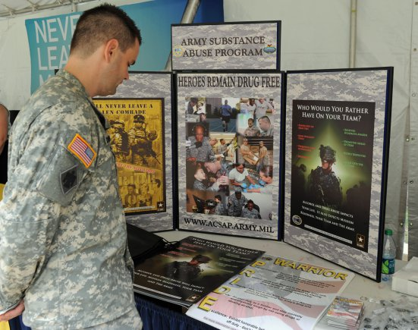
Army Emergency Relief. Red Cross | Family Readiness Groups / Virtual Family Readiness Groups
Army Family Advocacy Program. Victim Advocacy Program. | Employment Readiness Program
ARNG Soldier & Family Assistance Centers | Financial Readiness Program
Army OneSource | Military Family Life Consultants (MFLC)
Army Substance Abuse Program | Military OneSource (Note: This is not a military crisis line.)
Better Opportunities for Single Soldiers Program (BOSS) | New Parent Support Service
Chaplains / Strong Bonds | Relocation Counseling Program
Child Youth & School Services | Sexual Harassment/Assault and Response Program (SHARP)
Comprehensive Soldier and Family Fitness | Survivor Outreach Services
Veterans Administration (VA) | Yellow Ribbon Reintegration Program / Warrior Transition Unit (WTU)
Employee Assistance Program (EAP) | USAR’s Fort Family Outreach and Support, Army Strong Community Centers
Exceptional Family Member Program | Behavioral Health Services
ACE-SI
Non-Emergency
Resources
(Exercise 7 continued)
37
Notes:
Directions: Direct attention to the resources listed on the slide but do not read them. Use the talking points to talk about these resources. Read the Example Speaker’s Notes for ideas on how to talk about this. The facilitator will point out that Leaders plan ahead.
Talking Points:
Leaders plan ahead: these are non-emergency resources and can be used for counseling or information.
Historically, risk factors present in suicide case studies are:
Relationship issues.
Depression
Prior suicide attempt
Family history of suicide
Financial issues.
Legal issues.
What are some resources that could have helped with those issues before they became emergencies?
Your chain of command is a source of immediate advice and referral.
Confidential resources include the Chaplain, MFLAC, and Military One Source.
If time allows, then you will pick one non-emergency resource to research and find out its location, hours of operations, and phone number.

Slide 43
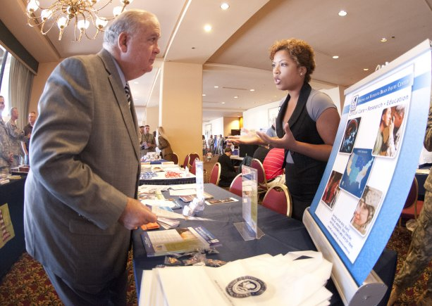
ACE-SI
Community
Resource Guides
Cover wide range of care from prevention to education to treatment (visit your Installation
Website)
Example of services locally:
Faith Centers
Alcohol and Substance Abuse
Dental Care
Hypertension Checks
Nutrition Education
PTSD
Stress Management
http://phc.amedd.army.mil/topics/healthyliving/hpr/Pages/CommunityResourceGuides.aspx
38
Notes:
Directions: This slide will be displayed while you discuss the results from exercise 7. Use the talking points to talk about Community Resource Guides. Read the Example Speaker's Notes for ideas on how to talk about this.
Talking Points
Community Resource Guides are installation specific and often available online. They can help you find the types of non-emergency resources you need.
Don’t forget your chain of command as a resource.
Point out to the groups that the SPPM has a resource list available for them to use too.
During the last exercise you researched some of these resources. Please add the website for your personal Army Post/Installation Community Resource Guides that you are assigned to or use.
The point of this exercise is it takes a long time to get information and you as a Leader need the information at your fingertips.

Slide 44
ACE-SI
Apps are additional resources for non-emergency use (Exercise 8, 10 min)
39
Notes:
Directions: For Exercise 8, direct attention to the handout pages for Useful Free Apps. Use the talking points to discuss apps. Read the Example Speaker's Notes to see ways to facilitate this section of the training. If time permits and access is available, have each group take 5 minutes to download at least one app onto a Smartphone and examine it, and 5 minutes to discuss it. If a student does not have a Smartphone, have them share or observe someone who does. (Note: If you are running out of time refer training participants to the handout and have them do the exercise on their own.)
Talking Points:
Apps can be another non-emergency resource for you to use or recommend.
The Useful Free Apps page in your handouts list some apps and describes them.
Other Apps are available for use as a non-emergency resource. Look for Army, DoD and Defense Centers of Excellence (DCoE) apps on the internet.
The POS-REP app is currently only available for IPhone's at this time. Android app is under development.
Military Traveler App is an internet based directory of installation services and resources located throughout the world.
Are there any other Apps that you have found useful?
The point of this exercise is that there are many free apps and websites that can help in the fight against suicide.
As a Leader you should plan ahead by having these tools in your tool kit (at your fingertips).

Slide 45
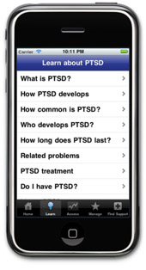
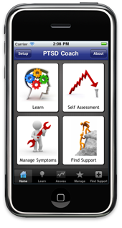
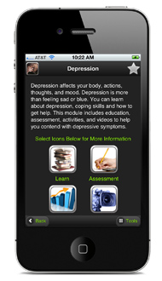
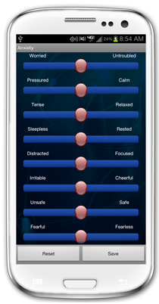
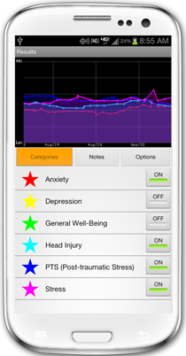
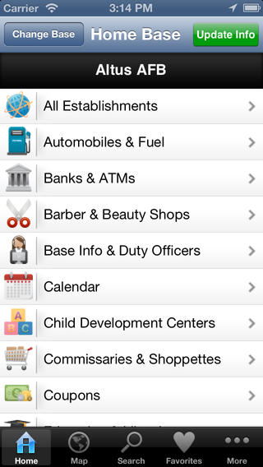
ACE-SI
App screenshots resources for non-emergency use
40
Notes:
Directions: This slide shows screen shots for the following Smart Phone Apps: Breathe2Relax, PTSD Coach, Military Traveler, and Mood Tracker.
Talking Points:
Point out which screen shots are for Breathe2Relax, PTSD Coach, Mood Tracker, and Military Traveler.
Explain how to find these apps (go to App store on phone or computer web browser and type inquiry in search field)

Slide 46
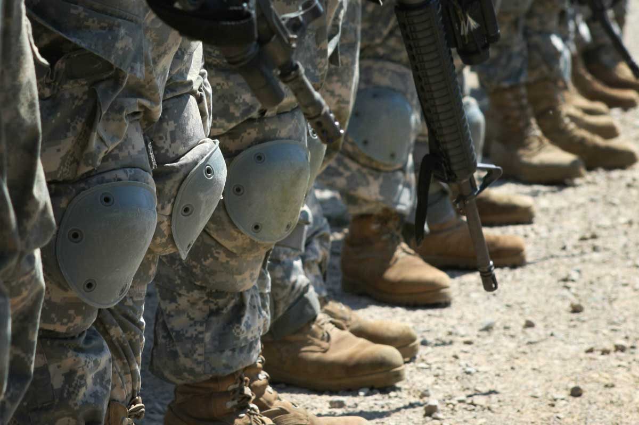
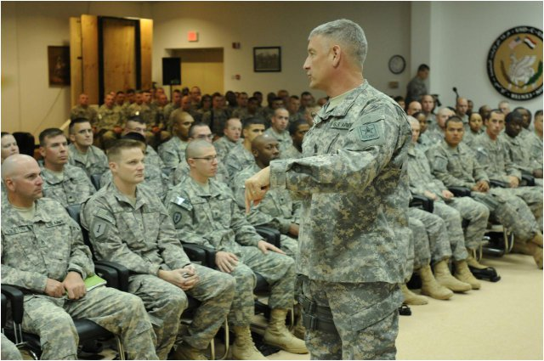
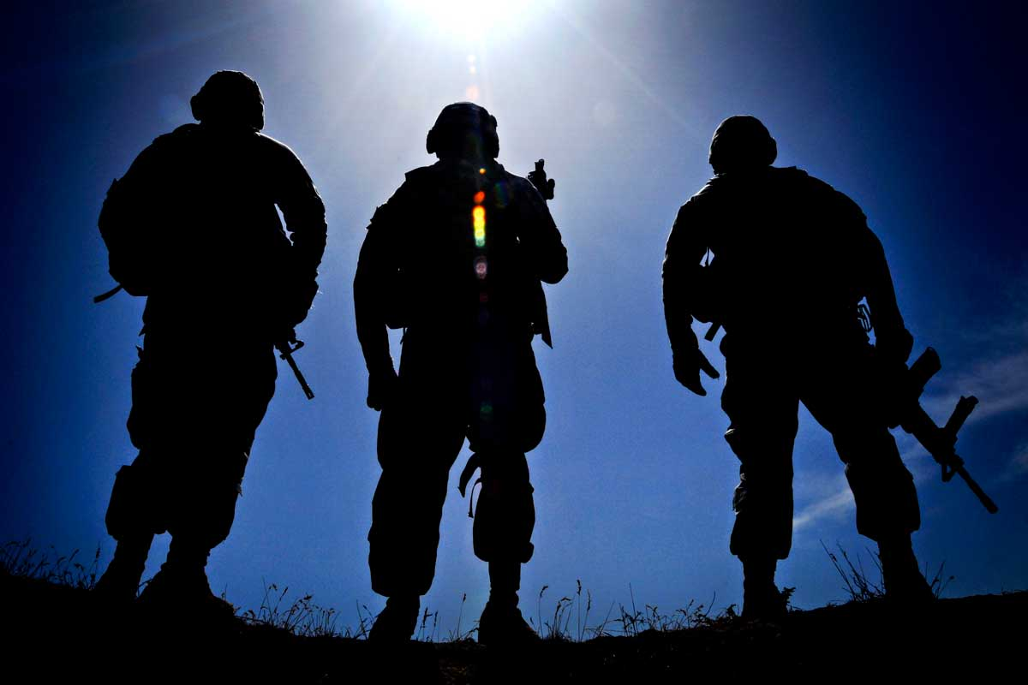
ACE-SI
Postvention
What should you do after a suicide or attempted suicide?
Inform your Chain of Command.
What else?
41
Notes:
Directions: Direct attention to the slide but do not read it. Use the talking points to talk about Postvention. Read the Example Speaker’s Notes for ideas on how to talk about this.
Talking Points:
Inform your chain of command.
Postvention refers to actions required after a suicide attempt or death by suicide to reduce the risk of contagion.
The definition of Postvention is in the handout and is not in a dictionary.
The local commander(s) (Installation Commander) should have a Postvention action plan to execute if there has been a suicide attempt or a death by suicide.
A suicide within an organization increases risk for others within that organization; and places individual at greater risk for another attempt or a completed suicide.

Slide 47
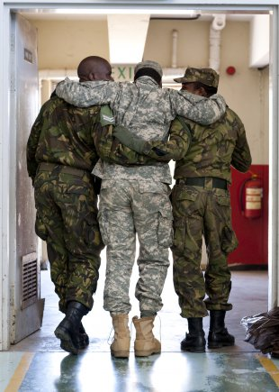
ACE-SI
First Line Leader Example
of Postvention Actions
Support fellow Soldiers, leaders, co-workers, Families, and friends
Express sympathy.
Have a Chaplain or counselor address groups.
Schedule meetings with a Chaplain/counselor for individuals.
Consider attending memorial services and encouraging
others to do so.
Communicate (professionally or privately) in ways that reduce
the risk of suicide for others
Don’t vilify the person who died.
Be respectful of the feelings of Family, friends, co-workers.
Don’t focus on the means of death.
Support Soldiers returning to the unit after counseling or treatment
Help them reintegrate.
Act to prevent stigmatization.
Follow up to ensure compliance with any on-going treatment.
42
Notes:
Directions: Direct attention to the slide and ask training participants to read it. Allow time for them to do so then use the talking points to discuss postvention actions and resources. This slide is just an example of Postvention actions that Leaders should take. Read through the Example Speaker’s Note for suggestions on how to facilitate this section.
Talking Points:
First line leaders:
Support fellow Soldiers, leaders, Family, friends, co-workers.
It is important to quickly address the situation to reduce the likelihood of suicide by contagion.
Communicate in ways do not vilify the person who died or focus on the means of death.
Support reintegration of Soldiers after treatment, and encourage the person to continue treatment if needed.
Follow up in the following months.
Bring in chaplains, counselors and grief counselors as valuable resources to assist with…
The local commander/Installation Commander should have a Postvention action plan to execute if there has been a suicide attempt or a death by suicide.
This information is just an abbreviated list of what is presented in DA Pam 600-24 concerning Postvention actions and requirements.

Slide 48
ACE-SI:
In this Lesson you have
Described differences between emergency resources and non-emergency resources.
Identified local suicide prevention resources.
Used mobile devices to explore designated suicide-related apps and websites.
Discussed appropriate postvention resources/actions to be used in the event of a suicide or suicide attempt.
43
Notes:
Directions: Display slide and summarize what they have learned in this lesson.
Talking Points:
Slide shows what we have done in this lesson.
Any questions?

Slide 49
ACE-SI
Terminal Learning Objectives (TLOs)
Identified the problem and impact of suicide in the Army and your role as a leader in preventing suicide.
Identified suicide risk factors and protective factors, and identified stigma that may prevent Soldiers from seeking help when needed.
Demonstrated your ability to identify risk and intervene when a Soldier exhibits the warning signs of suicide.
Selected the appropriate resource to use based on risk, warning signs, and in response to a suicide or suicide attempt.
44
Notes:
Directions: Call attention to slide and restate objectives of training that they completed.
Answer any questions remaining in the Parking Lot.
Ask for additional questions. .
Talking Points:
Here is what we have covered in the training.
Let’s see if we have addressed all the Parking Lot questions.
Are there any additional questions?
Remember you as a LEADER have a crucial ROLE in preventing Suicides…. YOU HAVE TO ASK THE QUESTION!

Slide 50
ACE-SI
Chief of Staff of the U. S. Army
45
Notes:
Directions: Play video of CSA General Raymond T. Odierno.
Talking Points:
This is a message from the Chief of Staff of the Army, General Raymond T. Odierno, about the importance of what you have learned today and about your role as a leader in preventing suicide.
Remember you as a LEADER have a crucial ROLE in preventing Suicides…. YOU HAVE TO ASK THE QUESTION! As YOU may save a life.

Slide 51
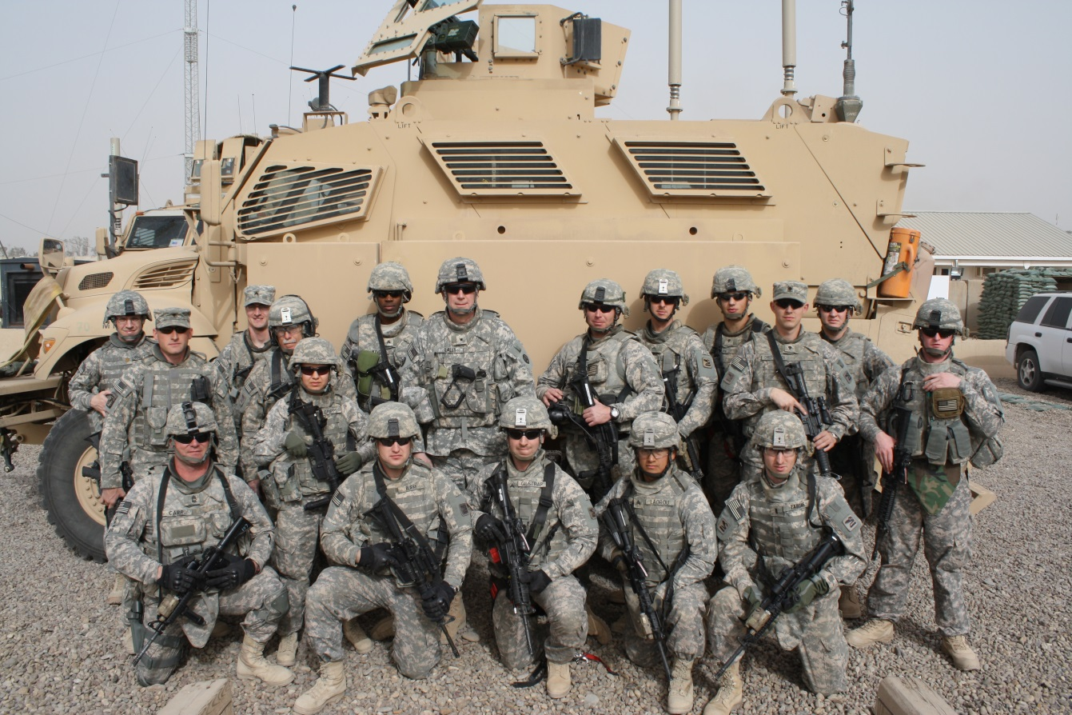
Congratulations!
You have Completed ACE-SI
46
Notes:
Directions: Hand out completion certificates. Thank the training participants. Dismiss the class. Remain in classroom a minimum of 15 minutes to speak to anyone who wants to talk further.
Talking Points:
Thank you for your attention and participation.
I will be in the classroom for a while if any of you have additional questions.
Hand out completion certificates.
Say Congratulations!!!!

